Slide 1
Week 9-10: Intro to Linear Programming
CS 5800
Dr. Alan Jamieson

Slide 2
What’re we talking about today, Alan?
Linear Programming
Problem specification
Graphically solving

Slide 3
Linear Programming
Some of our optimization problems can be modeled using linear relationships (basically, I can format them as a linear equation).
These are linear programming problems.
And they can be solved using this fun technique called MATH.

Slide 4
Linear Programming Formulation
But, we gotta get them in the right format first!
For any of these problems we will typically need to go from some kind of word problem and then converting it into our linear programming format.
As a simple example: I’m running a shop. I have room for 40 items on my shelf and have access to 30 boxes of tea and 30 bags of coffee. The tea costs $2 and I sell them for $5. The coffee costs $3 and I sell them for $7. Maximize profit.
Max z = 3t + 4c t <= 30 c <= 30 t + c <= 40

Slide 5
Example (Bronson and Naadimuthu)
The Village Butcher Shop traditionally makes its meat loaf from a combination of lean ground beef and ground pork. The ground beef contains 80 percent meat and 20 percent fat, and costs 80 cents per pound; the ground pork contains 68 percent meat and 32 percent fat, and costs 60 cents per pound. How much of each kind of meat should the shop use in each pound of meat loaf if it wants to minimize its costs and to keep the fat content of the meat loaf to no more than 25 percent?

Slide 6
Example (Bronson and Naadimuthu)
Formulation:
x = amount of ground beef, y = amount of ground pork
Minimize: z = 80x + 60y
Subject To: 0.2x + 0.32y <= 0.25
x + y = 1
Hidden constraint: all variables nonnegative (x >= 0, y >= 0)

Slide 7
Example (Bronson and Naadimuthu)
A hiker plans to go on a camping trip. There are five items the hiker wishes to take with her, but together they exceed the 60-lb weight limit she feels she can carry. To assist herself in the selection process she has assigned a value to each item in ascending order of importance:
Which items should she take to maximize the total value? Formulate this problem.
Item | 1 | 2 | 3 | 4 | 5
Weight | 52 | 23 | 35 | 15 | 7
Value | 100 | 60 | 70 | 15 | 15

Slide 8
Example (Bronson and Naadimuthu)
Maximize: z = 100v + 60w + 70x + 15y + 15z
Subject To: 52v + 23w + 35x + 15y + 7z <= 60
v, w, x, y, z <= 1
all values nonnegative and integral

Slide 9
Now you: Example Problem (Hiller & Lieberman)
The WYNDOR GLASS CO. produces high-quality glass products, including windows
and glass doors. It has three plants. Aluminum frames and hardware are made in
Plant 1, wood frames are made in Plant 2, and Plant 3 produces the glass and
assembles the products.
The company is launching two new products having large sales potential:
Product 1: 8’ glass door with aluminum framing ($3000 profit/batch)
Product 2: 4’ x 6’ double-hung wood-framed window ($5000 profit/batch)
Product 1 requires some of the production capacity in Plants 1 (1 hr/batch) and 3
(3 hr/batch). Product 2 requires Plants 2 (2 hr/batch) and 3 (2 hr/batch).
Marketing has determined that the company could sell as many of either product as
production allows. Determine what mix of products net the largest profit
considering that the amount of available time for Plant 1 is 4 hours, Plant 2 is 12
hours, and Plant 3 is 18 hours per week. Formulate this problem.

Slide 10
Now You: a more complicated exercise
(Bronson & Naadimuthu)
A 400-meter medley relay involves 4 different swimmers, who successively swim 100 meters of the backstroke, breaststroke, butterfly, and freestyle. A coach has six very fast swimmers whose expected times in the individual events are below. What should be the relay assignment be (formulate the problem first!)?
 | Backstroke | Breaststroke | Butterfly | Freestyle
A | 65 | 73 | 63 | 57
B | 67 | 70 | 65 | 58
C | 68 | 72 | 69 | 55
D | 67 | 75 | 70 | 59
E | 71 | 69 | 75 | 57
F | 69 | 71 | 66 | 59

Slide 11
How do we go about solving these problems?
Two primary ways:
Graphically - plot the lines, figure out what the best point is.
Algorithmically - simplex method

Slide 12
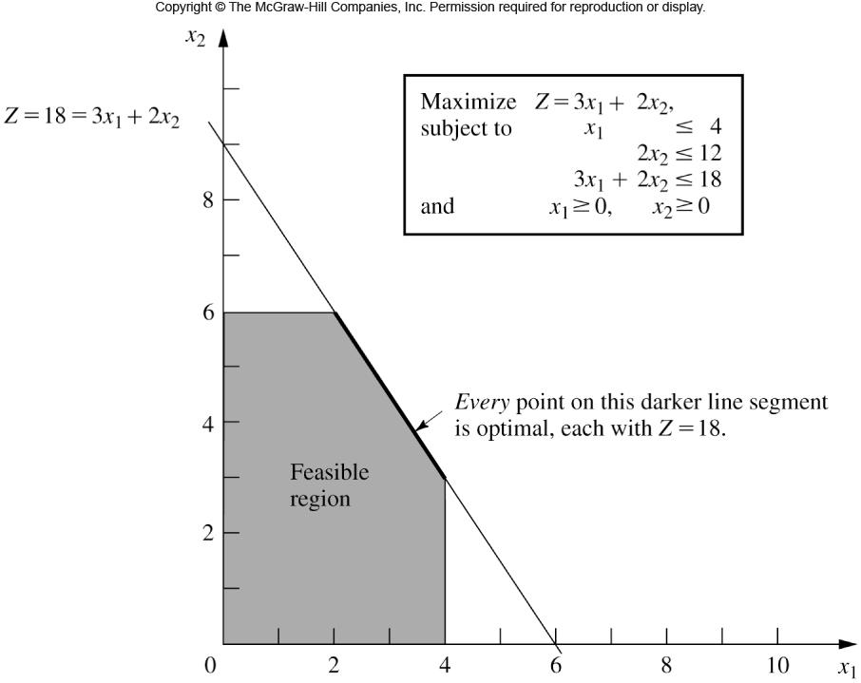
Fig. 3.5

Slide 13
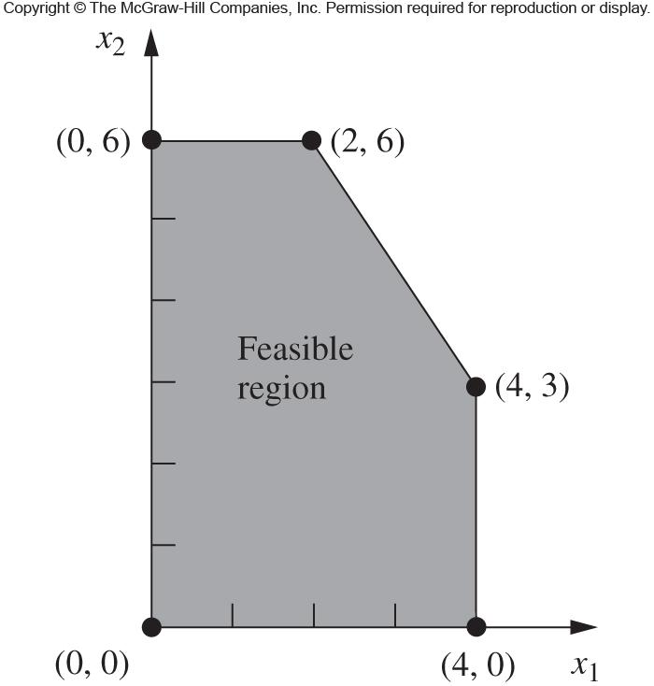
Fig. 3.7

Slide 14
Now you:
Take the WYNDOR GLASS CO. problem and solve it graphically. Does the answer you get make sense?
A great graphing utility for this is the Desmos graphing calculator web app.

Slide 15
On your radar:
Homework #5: due tonight
Homework #6 (FINAL HW): due next week - this is the paper reading assignment!
Final project: Algorithm choice/alternate algorithm proposal due Friday
Next week: research paper discussions for LP
Reading: Dasgupta, Chapter 7; Skiena, 16.6; Papers for next week

